Slide 1
Unit 1
Where’s Kitty？

Slide 2

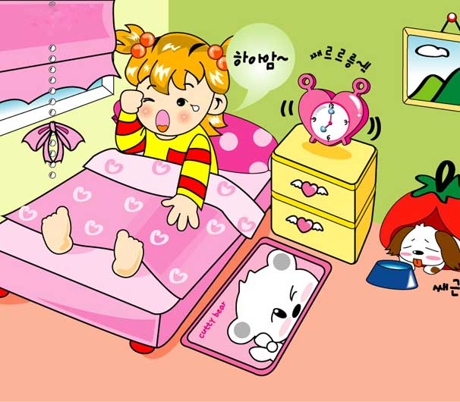
Where are my socks?
Where can they be?
Are they in the box?
Who can help me?

Slide 3
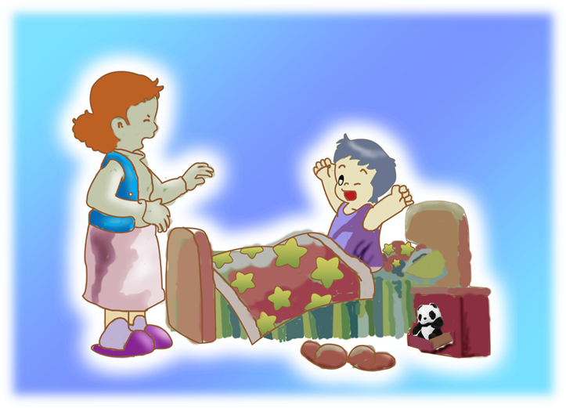
Where are my cap?
Where can it be?
Is it under the bed?
Please help me?

Slide 4

on
In front of
in
under

Slide 5
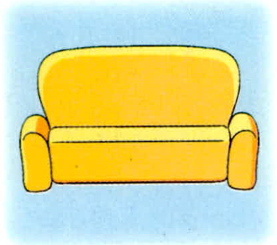


sofa
vase
basket

Slide 6
It’s in the box.

Slide 7
It’s on the box.

Slide 8

It’s under the box.

Slide 9
It’s behind the box.

Slide 10
It’s in front of the box.

Slide 11
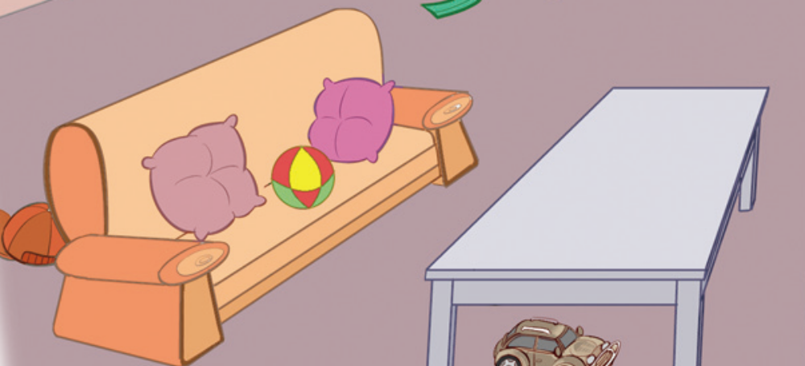
Where is my hat?
behind
The hat is the sofa.

Slide 12
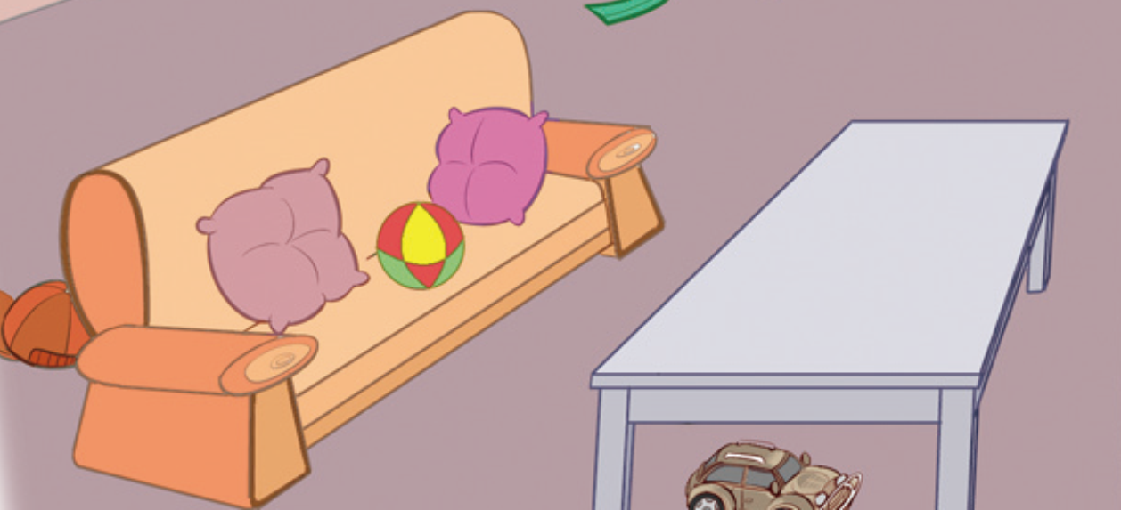
Where is my car?
under
The model car is the desk.

Slide 13
Where is the table?
in front of
The table is the sofa.

Slide 14
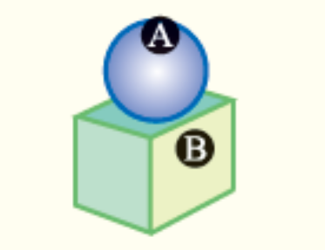



Show Time
on
A is B.
in
A is B.
behind
A is B.

Slide 15



under
A is B.
in front of
A is B.

Slide 16
Thank you !
Bye!

